Slide 1
Research Infrastructures:
Characteristics and Implications
Wouter Los
University of Amsterdam &
LifeWatch research infrastructure

Slide 2
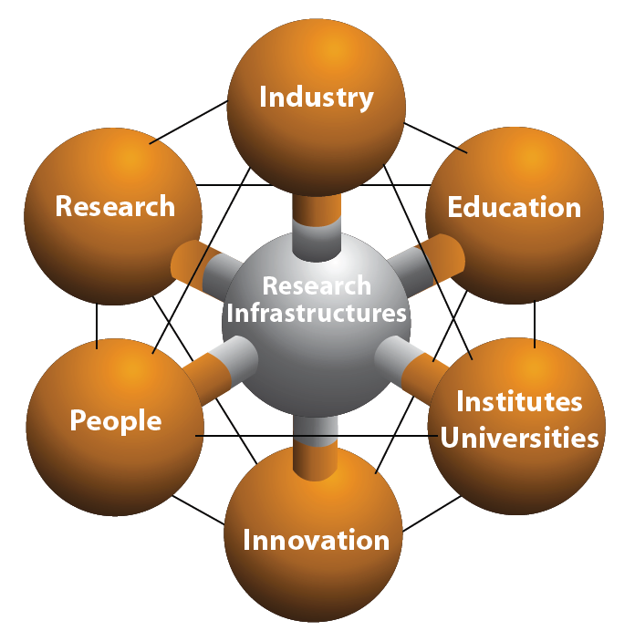

Slide 3
Scientific and technological drivers for infrastructure development
New scientific areas requiring new instrumentation
Expected breakthroughs
Higher resolutions in instrument outputs
Faster data generation and processing
Opportunities to operate data or instruments remotely (e-infrastructures)
Researchers are asking for new facilities (“market pull”)
New technologies offer new capabilities (“technology push”)

Slide 4
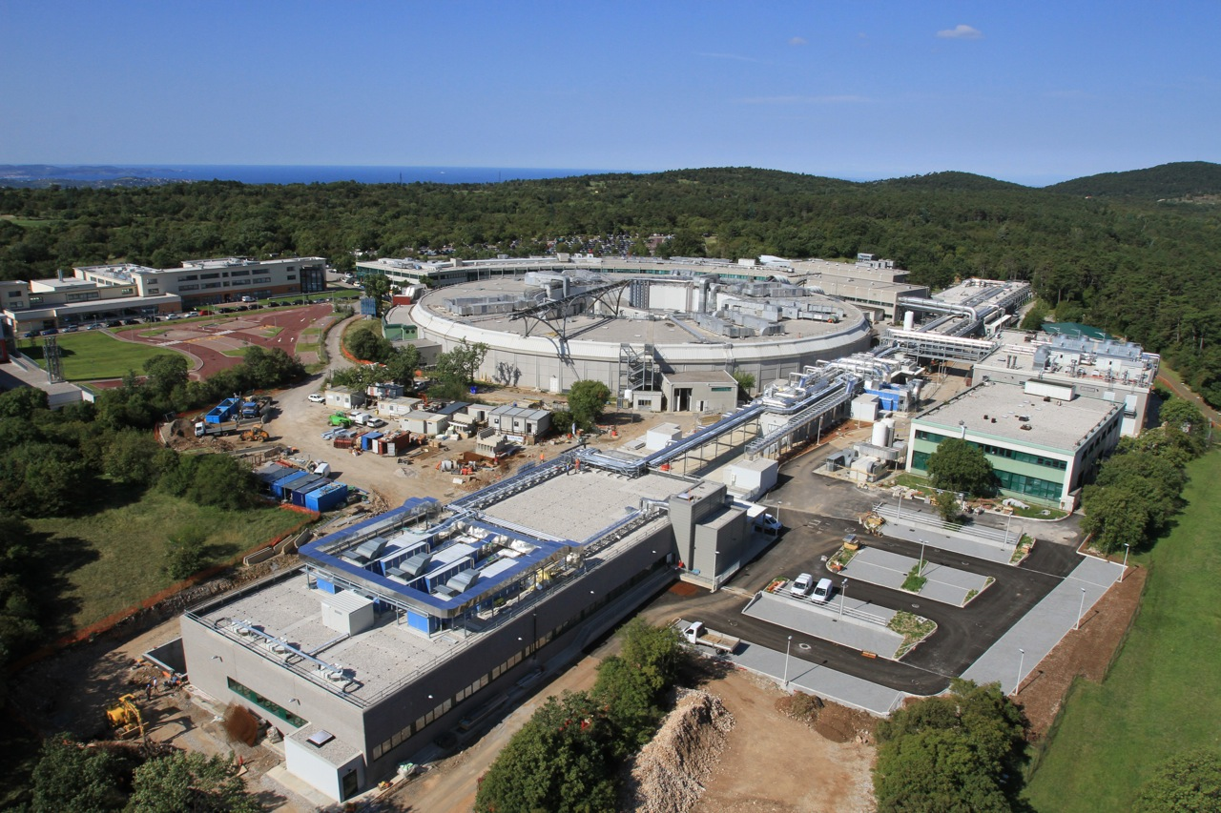
Elettra Sincrotone Trieste

Slide 5
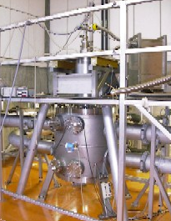
Linking existing high magnetic field laboratories
in Europe closer together.
• Laboratoire National des Champs
Magnétiques Intense (Grenoble & Toulouse)
• Hochfeld-Magnetlabor (Dresden)
• High Field Magnet Laboratory (Nijmegen)

Slide 6
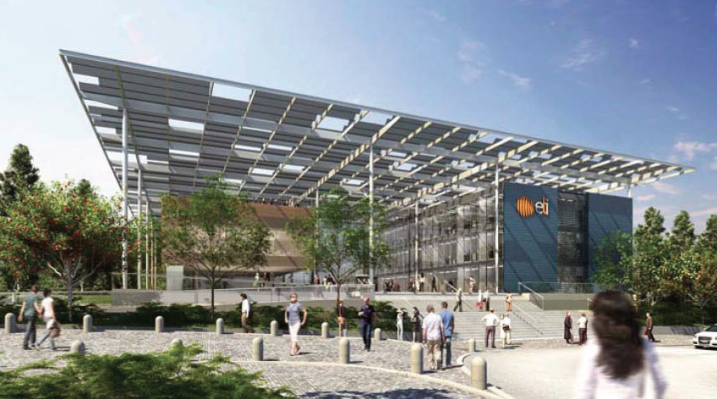
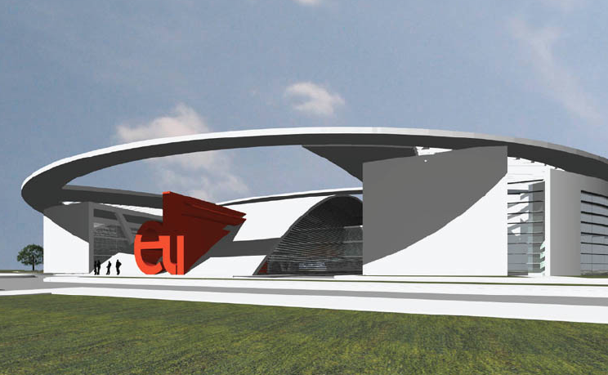
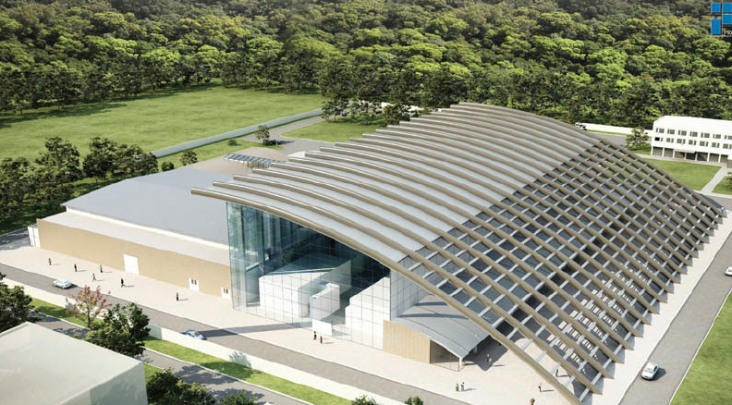
Distributed new research infrastructures
in a single organisation
ELI-Beamlines Facility
in the Czech Republic
ELI-Attosecond Facility
in Hungary
ELI-Nuclear Physics Facility
in Romania

Slide 7
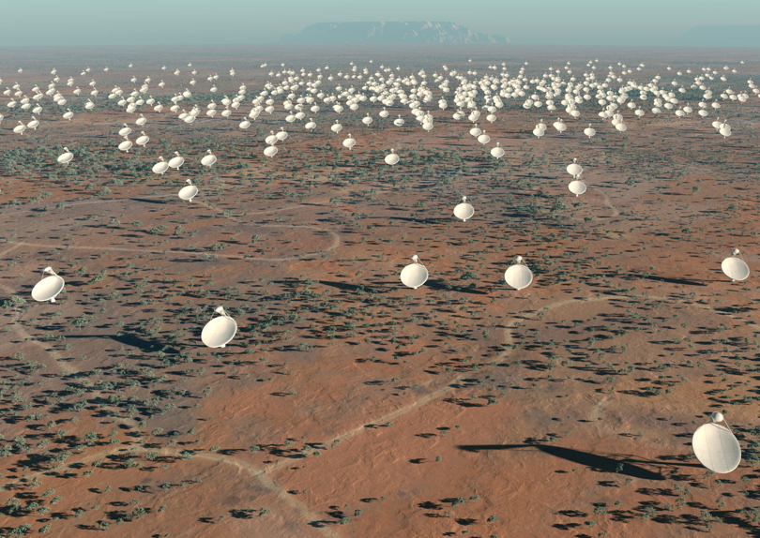
Square Kilometer Array
Artist's impression of the SKA dishes. Credit: SPDO/TDP/DRAO/Swinburne Astronomy Productions.

Slide 8
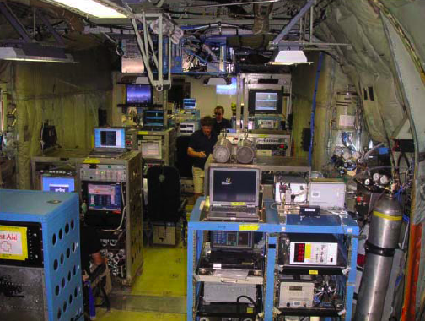
COPAL
Airborne measurements for multidisciplinary experiments
Heavy-payload (> 10 tons) and
long endurance (> 10 hours )
aircrafts with capabilities for
European scientists

Slide 9
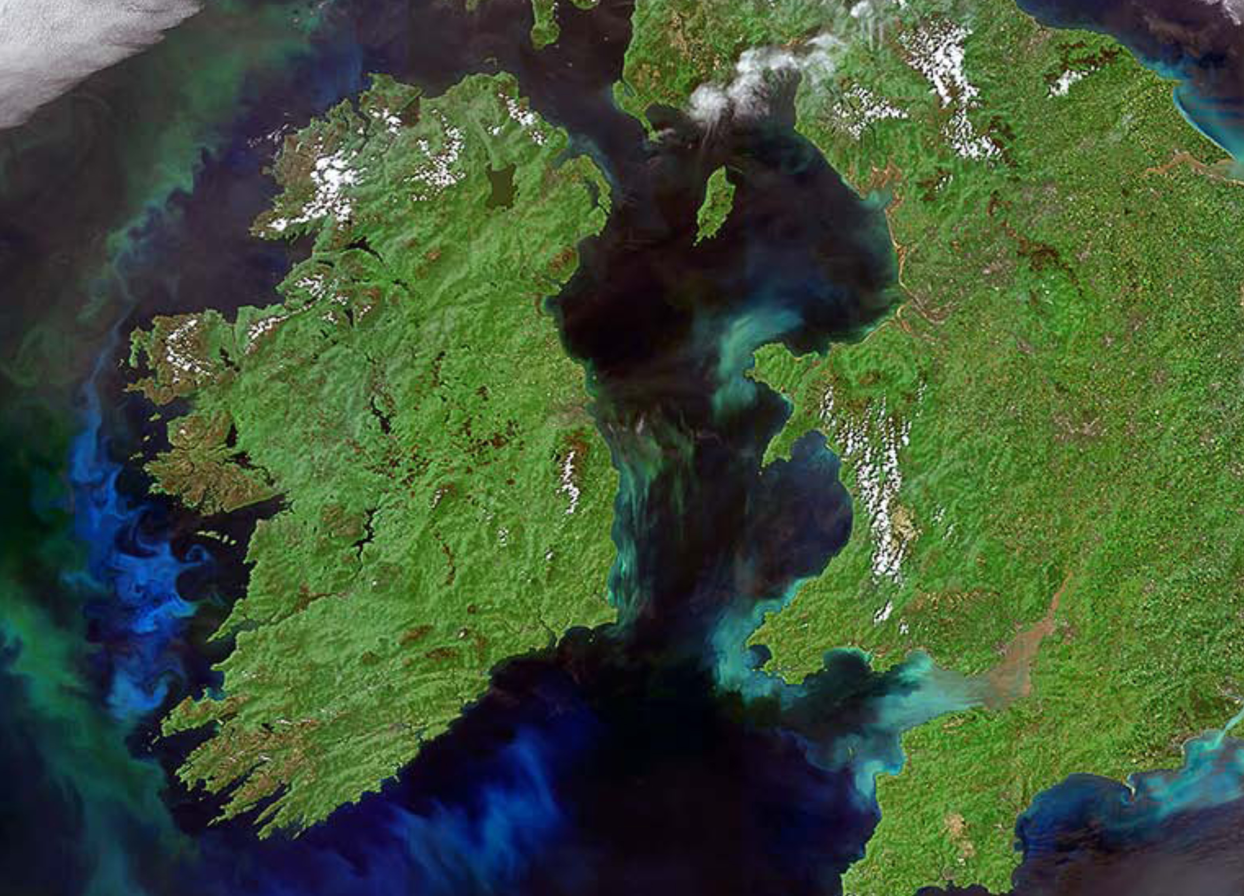
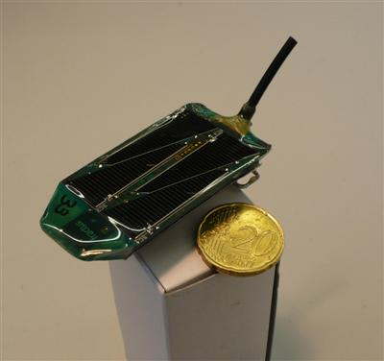
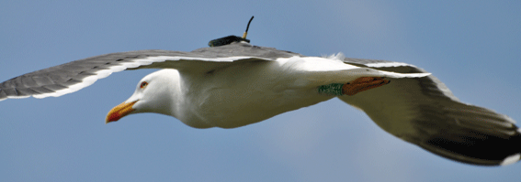
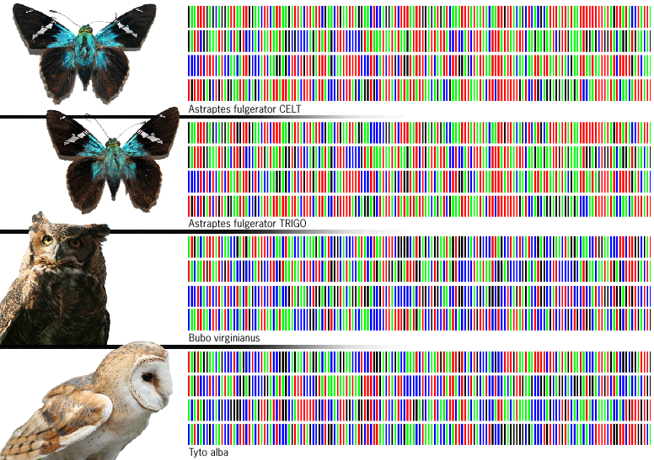
Instruments for biodiversity research infrastructures
www.sics.se

Slide 11
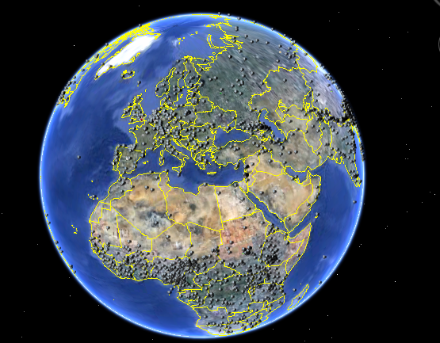
CLARIN
Virtual Language
Observatory

Slide 12
Negotiation
Infrastructure life cycle
Negotiation
Major
upgrade
Construction
Conception
Operation
Decommission

Slide 13
Perspectives of stakeholders
Researchers
Asking for free access
Requiring funding to benefit from the facilities
Universities
Expected to train new generations for using new infrastructures
Want to be close to research infrastructures
Industry
Depends on innovation to compete
Industries and infrastructures not always aware of opportunities and obstacles
Policy makers
Consider research infrastructures expensive
Often state: “priority for domestic researchers; the foreign user pays”
Expect benefits or negative effects for the country, region, city

Slide 14
The infrastructure perspective; mission and expectations
Commit to excellence and new knowledge
Serve users; provide free and open access
Operate at the scientific and technological forefront
Promote innovation
But also
Operate with often not secured (long-term) funding
Keep all stakeholders as a friend
Have to commit to non core objectives

Slide 15
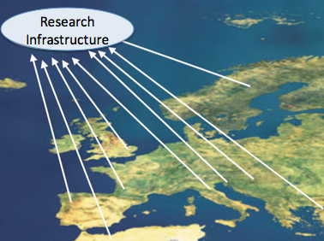
Present day challenges
Operating at the European/international scale
Increasingly interconnected research infrastructures
Offering remote access -> relation with e-infrastructures
Appropriate governance
& management
Legal structures
Financial engineering

